Slide 1



Assessing the Viability of Refueling at Asteroids on the Way to Mars
By: Julian Treat
Mentor: Dr. Davide Conte
Department of Aerospace Engineering
Embry-Riddle Aeronautical University

Slide 2
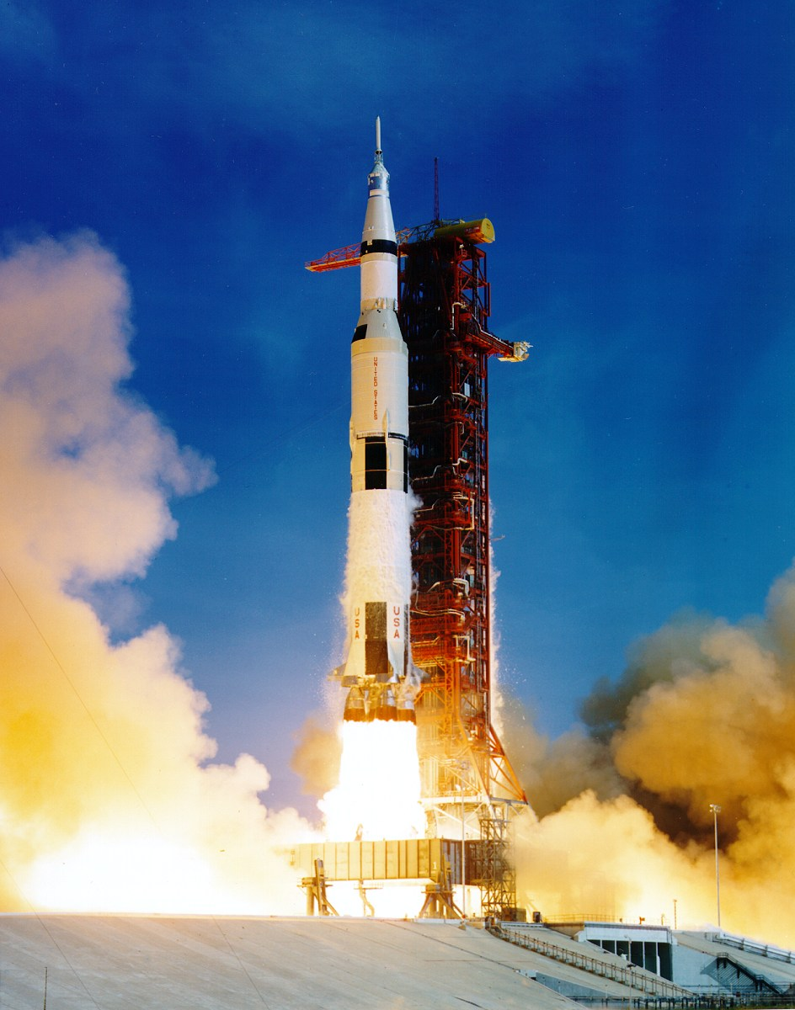
What is ΔV?
ΔV is the total change in velocity a spacecraft
Used to measure how hard it is to get some place in space
Source: NASA History Office
Notes:
This is an important term that is going to come up a lot, so I’m going to define it first. Delta-V is the measure of how much the spacecraft’s velocity has been changed by it’s engines or other means. This is important because changing our velocity is the only way to get anywhere in space, so we tend to measure missions with this metrics. For reference, it takes about 4.1 km/s of delta-v to get to Low Lunar Orbit, from low earth orbit, or about 14 km/s to get there from the earth. This is the Saturn five, the absolutely enormous rocket we used to get the apollo missions to the moon. This 363 foot tall behemoth – that’s about 53 of me stacked head to toe for scale - was needed to get to the moon. And it only delivered that absolutely tiny upper section. It weighed 6.5 million pounds, which is about 33k of me.
Only takes 4.1 km/s to get to Low Lunar Orbit from Low Earth Orbit.
About 14 km/s to get from Kennedy space center to low lunar orbit
Saturn V is 363’ tall – 53 of me stacked head-to-toe.

Slide 3
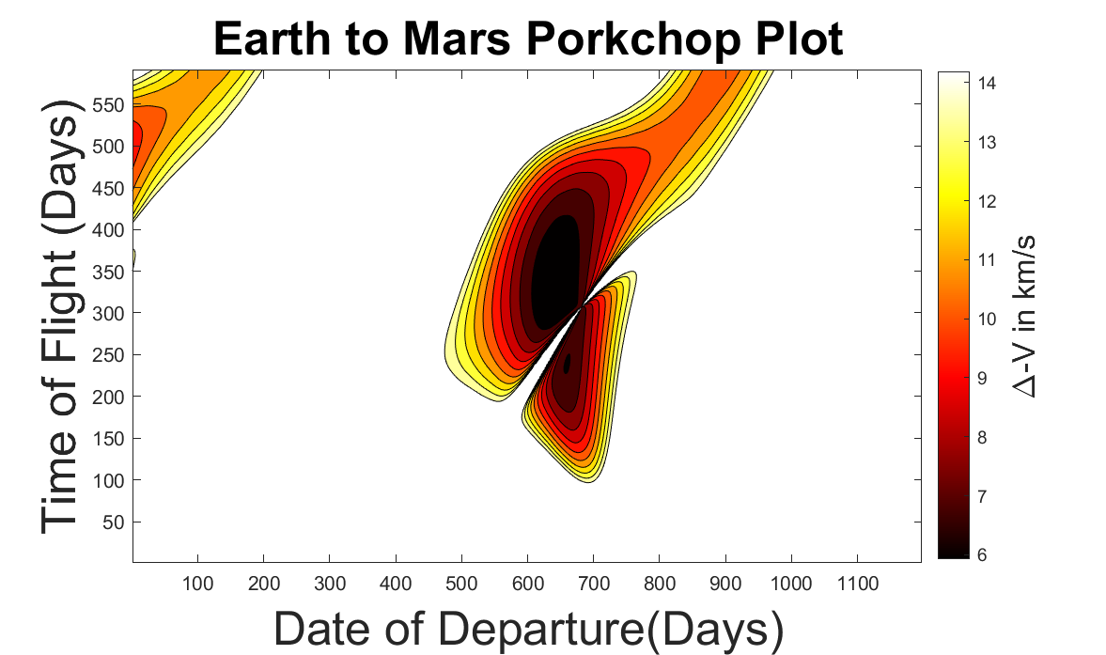
Mars is hard to get to
Notes:
Mars is even worse – we need 5.7 km/s of delta-V to get there from low earth orbit, minimum. This means it's about 15.8 km/s to get there from the earth. This is a porkchop plot, which displays the amount of delta-V to get someplace with respect to the departure date and the time of flight or the arrival date. The darker the color, the lower the delta v cost.

Slide 4
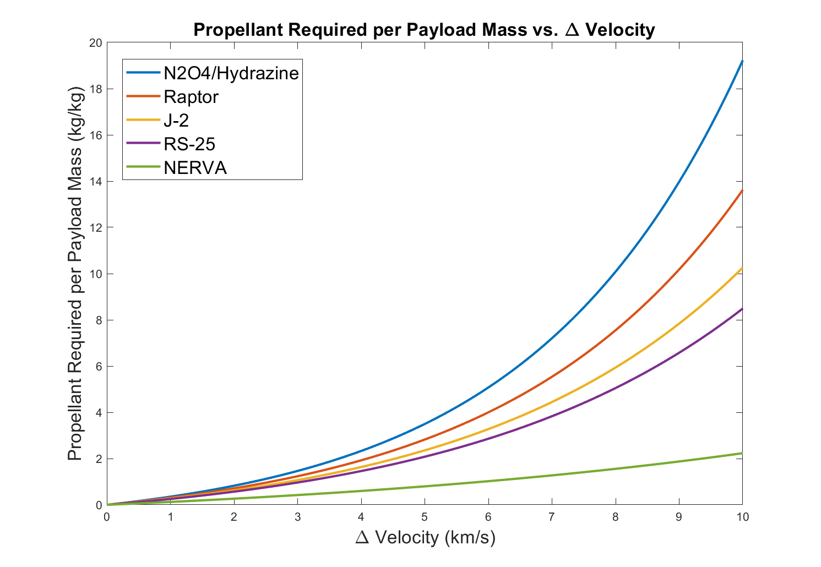
It gets worse
Notes:
The ‘Rocket Equation’ governs how much propellant we actually need. Unfortunately it’s an exponential equation, so to go somewhere we need a lot of propellant. From Low earth Orbit, using a SpaceX Raptor Engine, you would need about 3.61 tons of propellant for every ton of stuff you actually get to mars. The moon is a bit better, needing only 2 tons of propellant for every ton delivered there, but it’s still not great.
I don’t care how bad gas prices are, it doesn’t make sense to carry all of the gas you need for a cross country trip from where you started, so why should we carry all of the propellant we need for the mission with us? Can we refuel at some point on the way to mars?

Slide 5
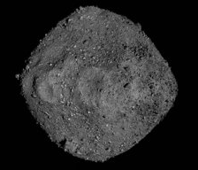
Stopping at an asteroid to fill up
Bennu was visited by the OSIRIS-REx mission
Water on Bennu!
Source: Goddard Space Flight Center
Notes:
Probably. Bennu was visited by the mission Osiris Rex, which confirmed the presence of water on it. This is exciting, because water can be turned into rocket fuel. Unfortunately, bennu is kind of difficult to get to from a delta-V perspective – it’s not an ideal candidate for such a mission profile. Are there other asteroids which are better for this mission?

Slide 6
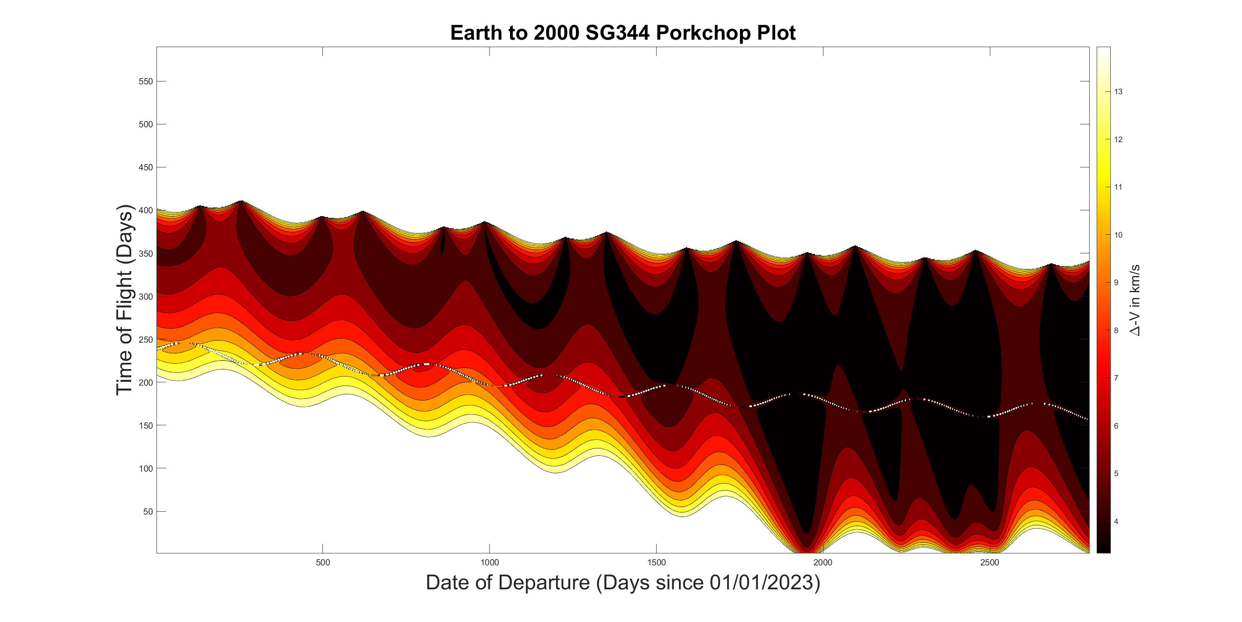
Yes
Notes:
2000 SG344 is a near earth asteroid somewhere between 15 and 70 meters in diameter. It is very easy to access from the earth, requiring only 3.5 km/s of delta-V at the optimal window and thus only 1.56 tons of propellant per ton of stuff we get there, which is much better than Getting to mars. We aren’t sure what this asteroid is made of – it could be a water rich carbonaceous asteroid we could refine plenty of propellant from, silicate type asteroid that we could at least get a substantial amount of the propellant mass from in the form of oxidizer, or a metallic type asteroid, which wouldn’t do us much good for propellant refueling. There is some debate as to whether or not this is actually the missing upper stage from Apollo 12, which would make propellant extraction exceedingly difficult.
2000 SG₃₄₄ is a small Near-Earth Asteroid
Can be accessed with 3.5 km/s of ΔV
Propellant cost of 1.56 tons/ton

Slide 7
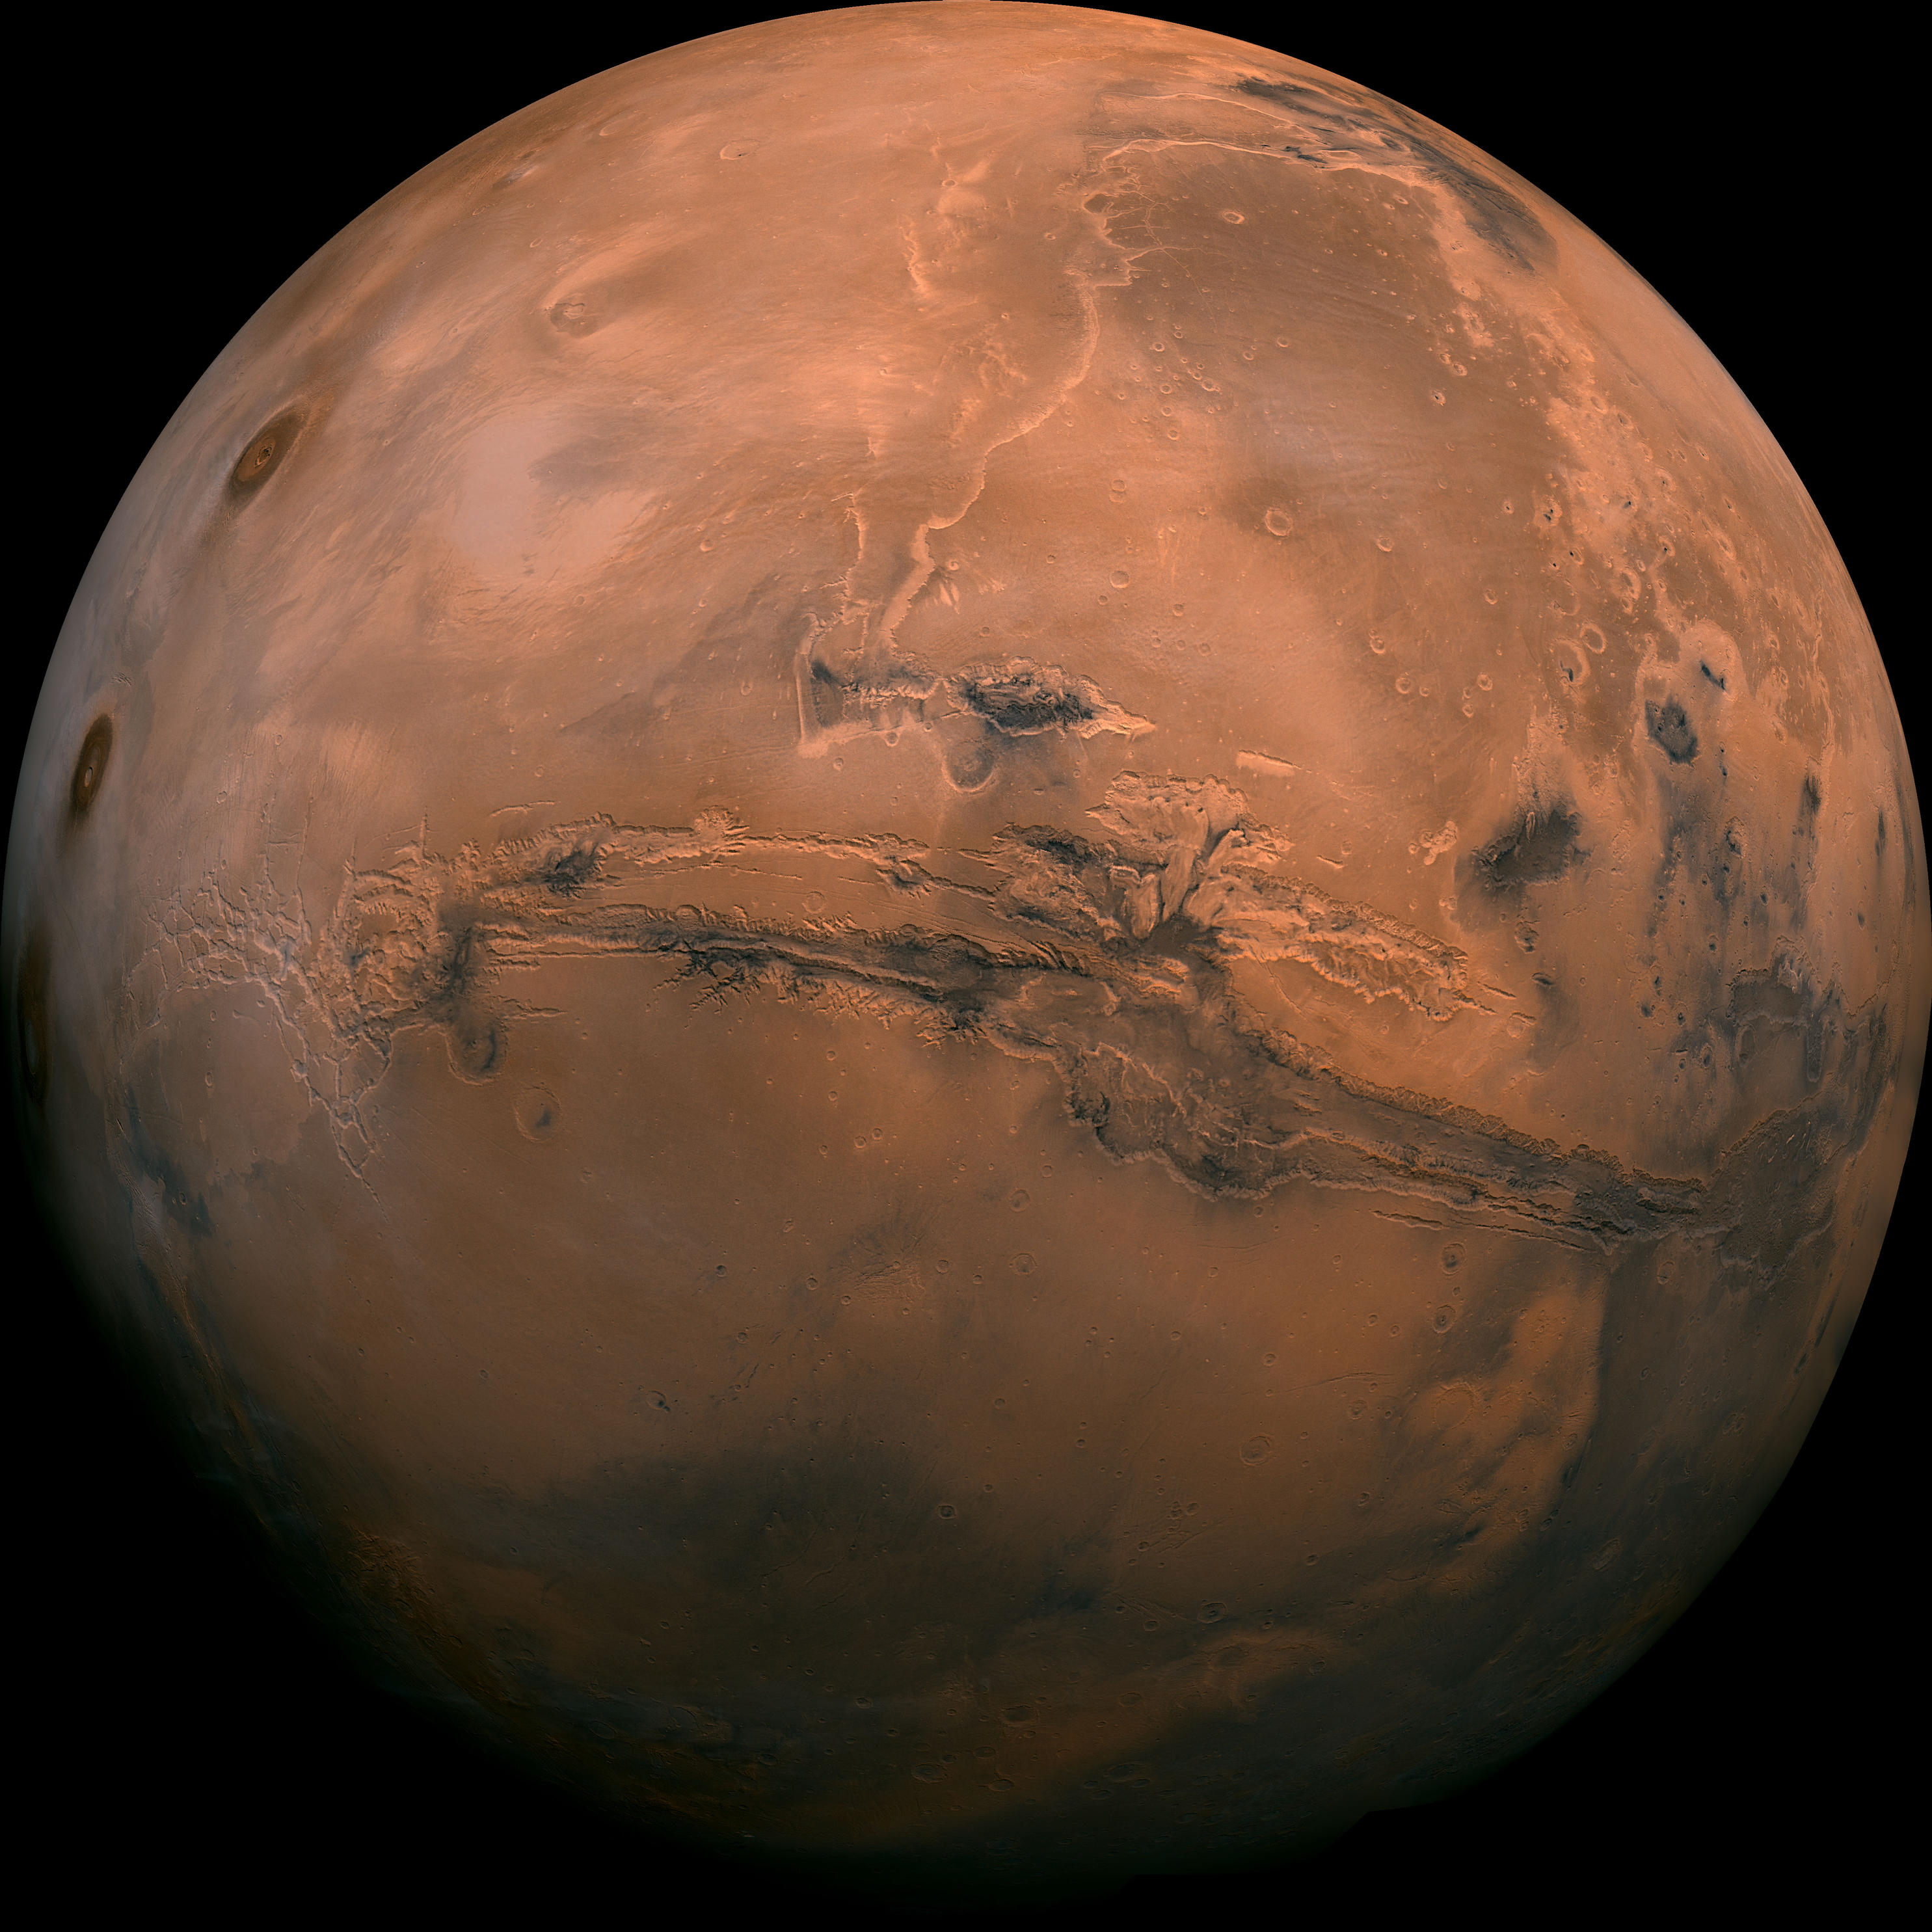
Future Work
Investigate transfer from Asteroid Candidates to Mars
Develop reference Missions
Time Optimal
Minimum mass
Time Optimal, but with layover
Source: NASA Solar System Exploration

